Slide 1


Slide 2

Implementation of Deep Learning Approach for detection of Plant Leaf Diseases

Slide 3
Group Members Introduction
Name: Ali Fraz
VU ID: BS180407311

Slide 4

INTRODUCTION OF PROJECT
To diagnose and classify apple & corn leaf diseases using deep learning techniques without soliciting agricultural experts for visual inspection.
Existing techniques require farmers to solicit the help of government-funded agricultural experts for diagnoses.
Labor-intensive, low-supply and costly
Viral diseases cause yield reduction and poor production.

Slide 5
With the help of data science, it is possible to identify these common diseases so they can be treated in time without effecting the production
A smart AI based solution has been developed for early diagnosis of diseases, through which disease identification is possible
We are using deep learning approach &Plant village dataset

Slide 6
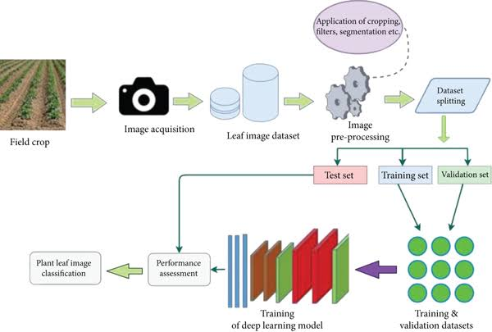
Process Model

Slide 7
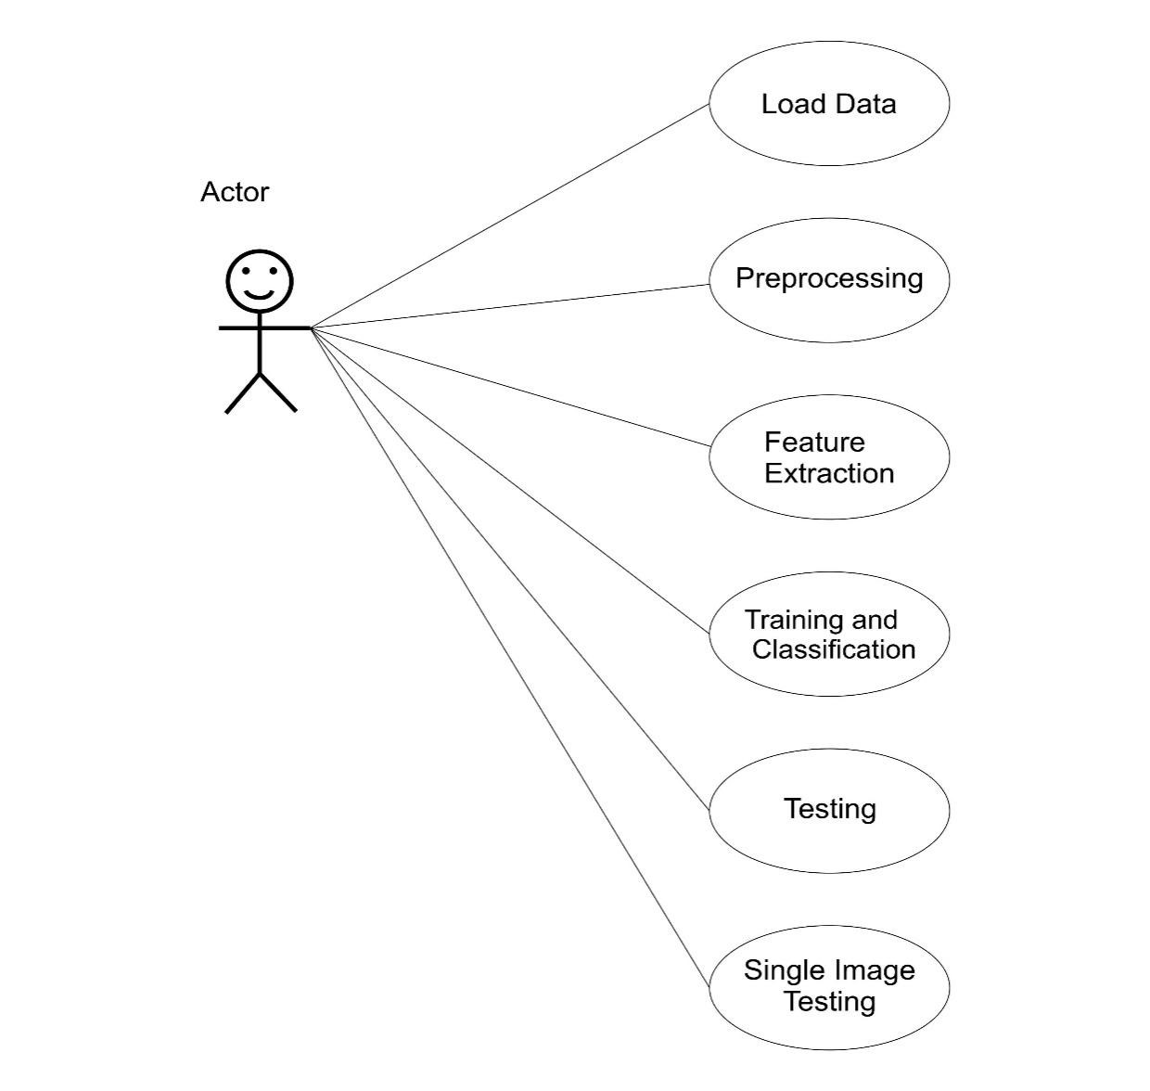
Use Case Diagram

Slide 8
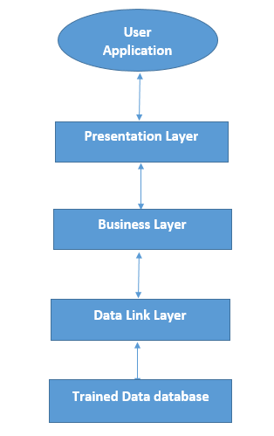
Architectural Design

Slide 9
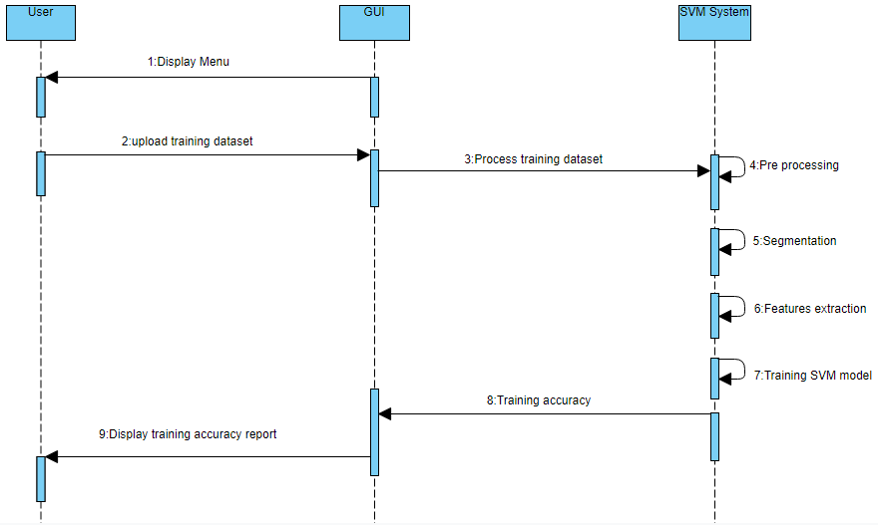
Sequence Diagrams

Slide 10
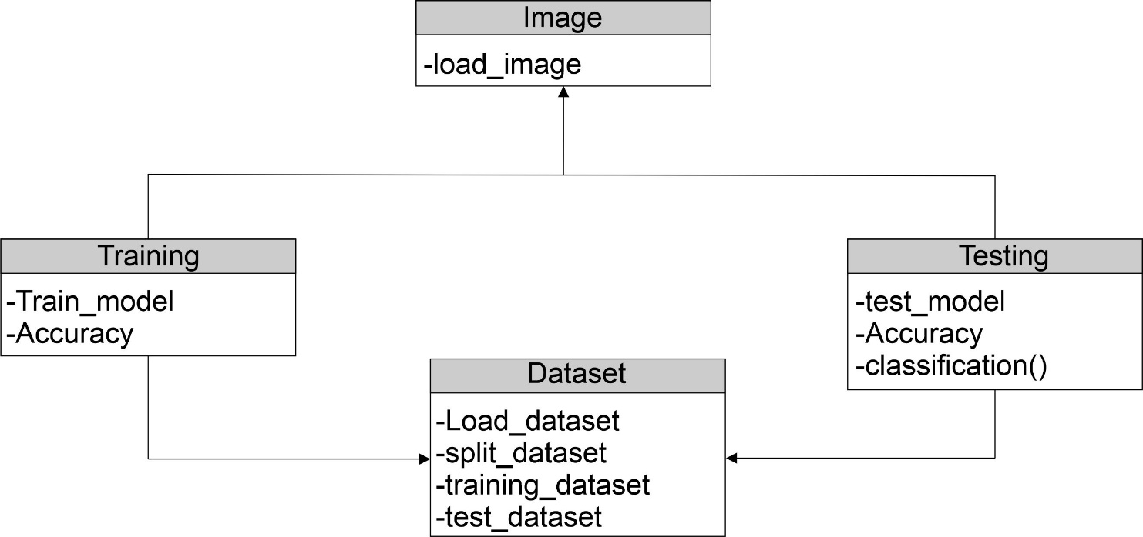
Logical Model/Class Diagram

Slide 11
Dataset
We use plant village dataset for detection of plant leave diseases
We use two plant categories apple & corn leaves diseases which have 8 classes, 4 classes belongs from apple and 4 classes belongs from corn leaves
Apple Diseases: apple leaves have three main diseases which affect most.
Apple scab
Apple black rot
Apple cedar apple rust
Apple healthy
Corn Diseases: corn leaves have three main diseases which affect most.
Corn cercospora leaf spot gray leaf spot
Corn common rust
Corn northern leaf blight
Corn healthy

Slide 12
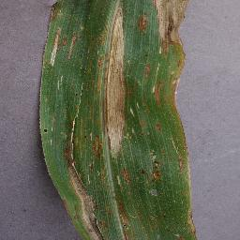
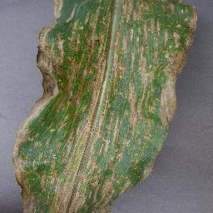
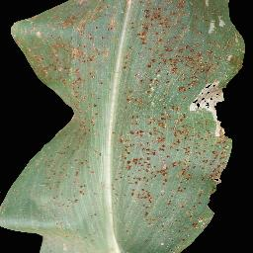
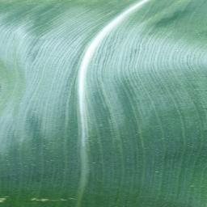
Sample images of Corn
Corn northern blight
Corn leaf spot gray
Corn common rust
Corn healthy

Slide 13
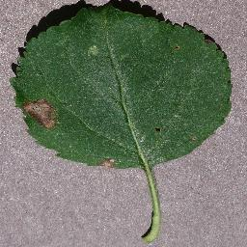
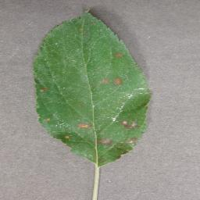
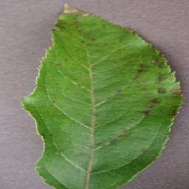
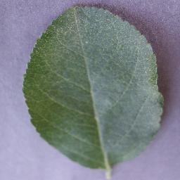
Sample images of Apple
Apple black Rot
Apple Ceder
Apple Scab
Apple healthy

Slide 14
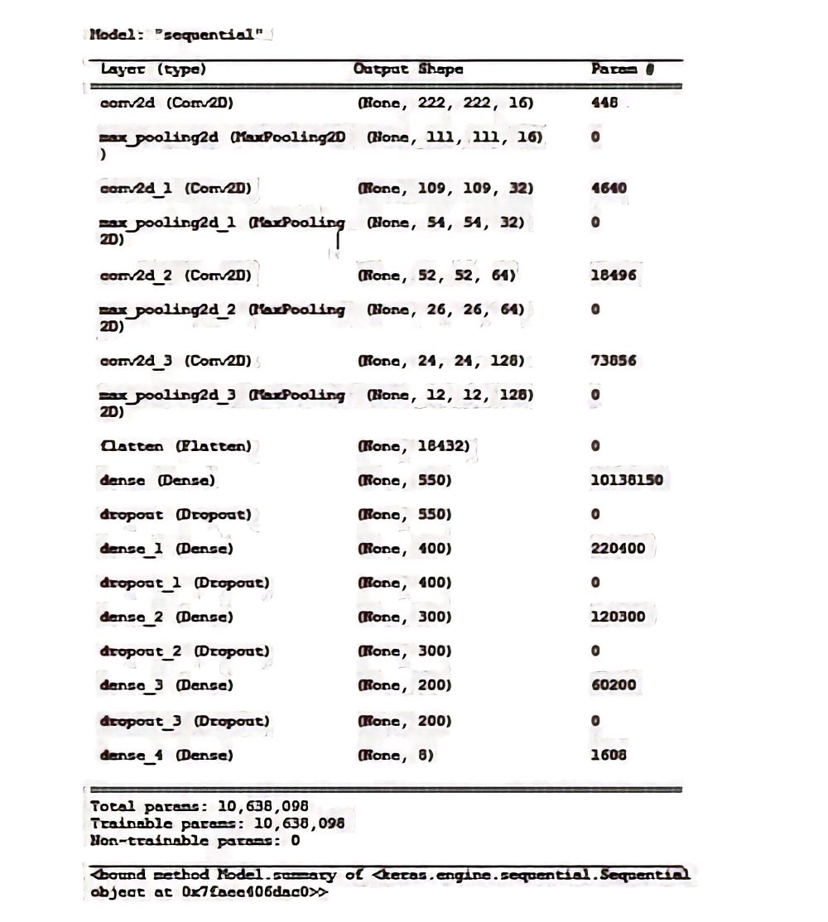
Model Summary
we have used sequential deep learning model as shown below

Slide 15
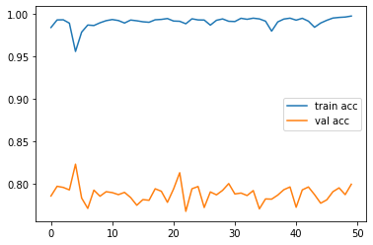
Model Training & Validation Accuracy Graph

Slide 16
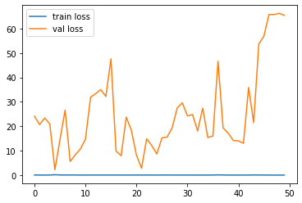
Model Training & Validation Loss Graph

Slide 17
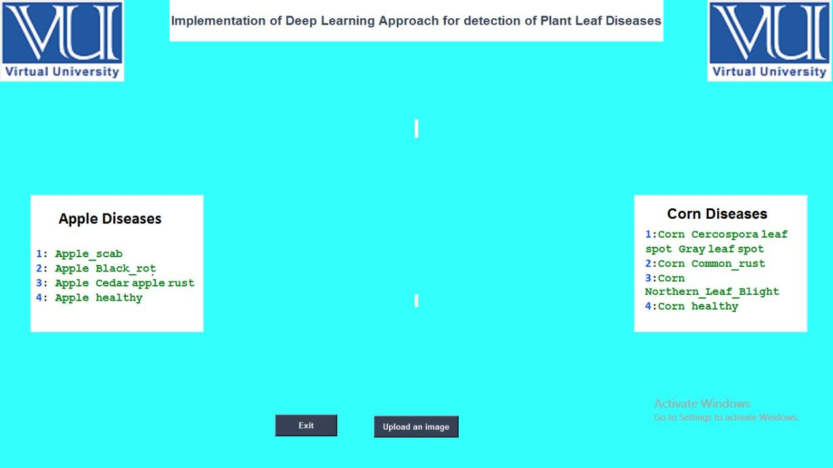
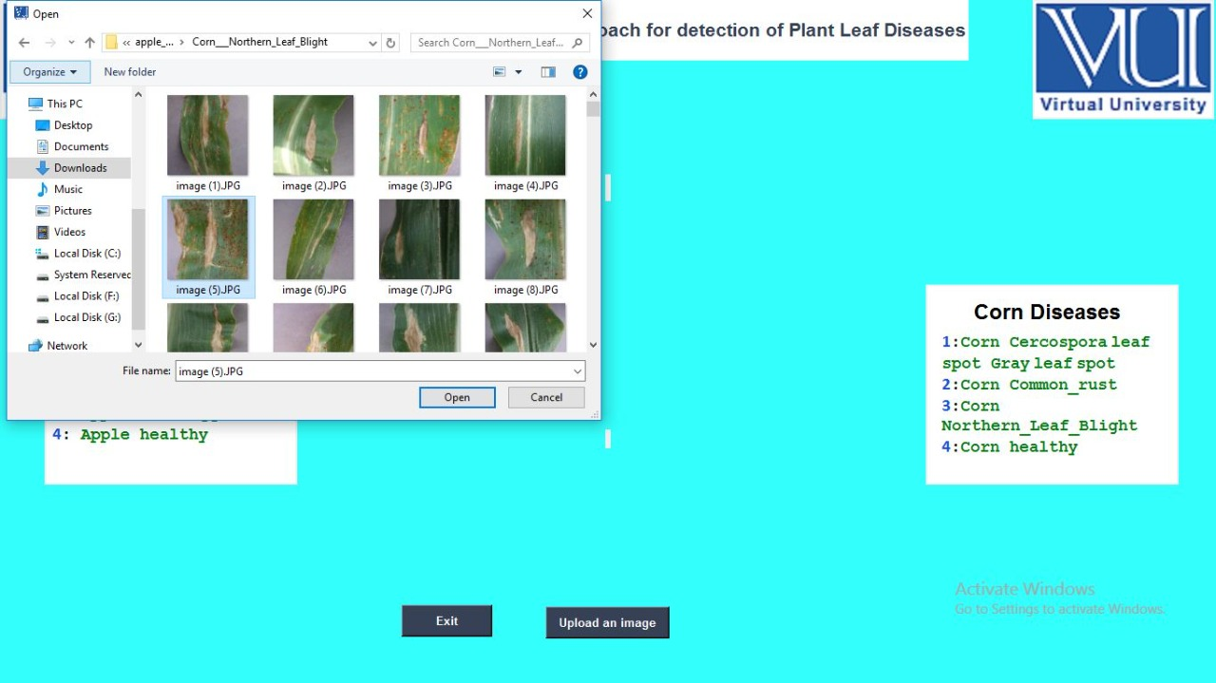
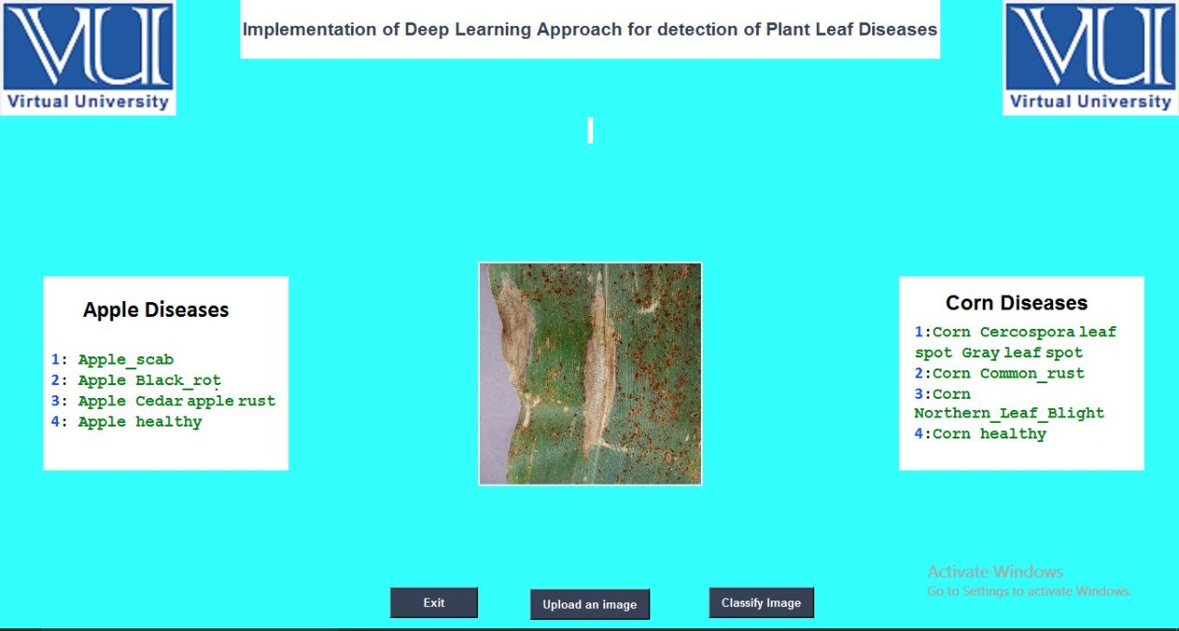
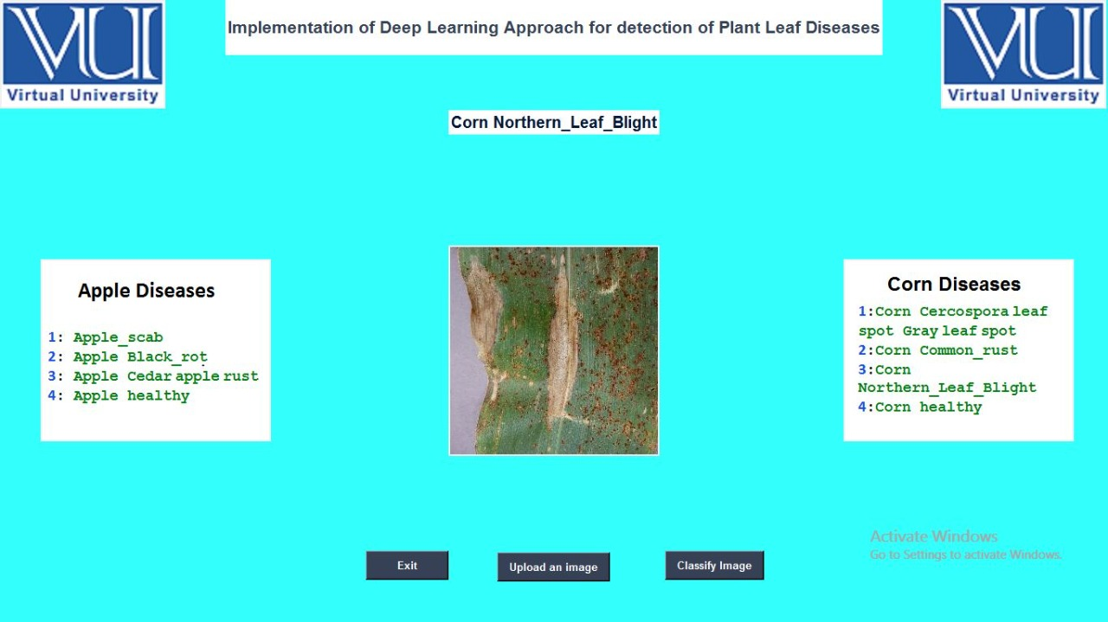
Graphical User Interface

Slide 18
Tools & Language
Google Colab
Pycharm
Python

Slide 19
Thank You

